Slide 1
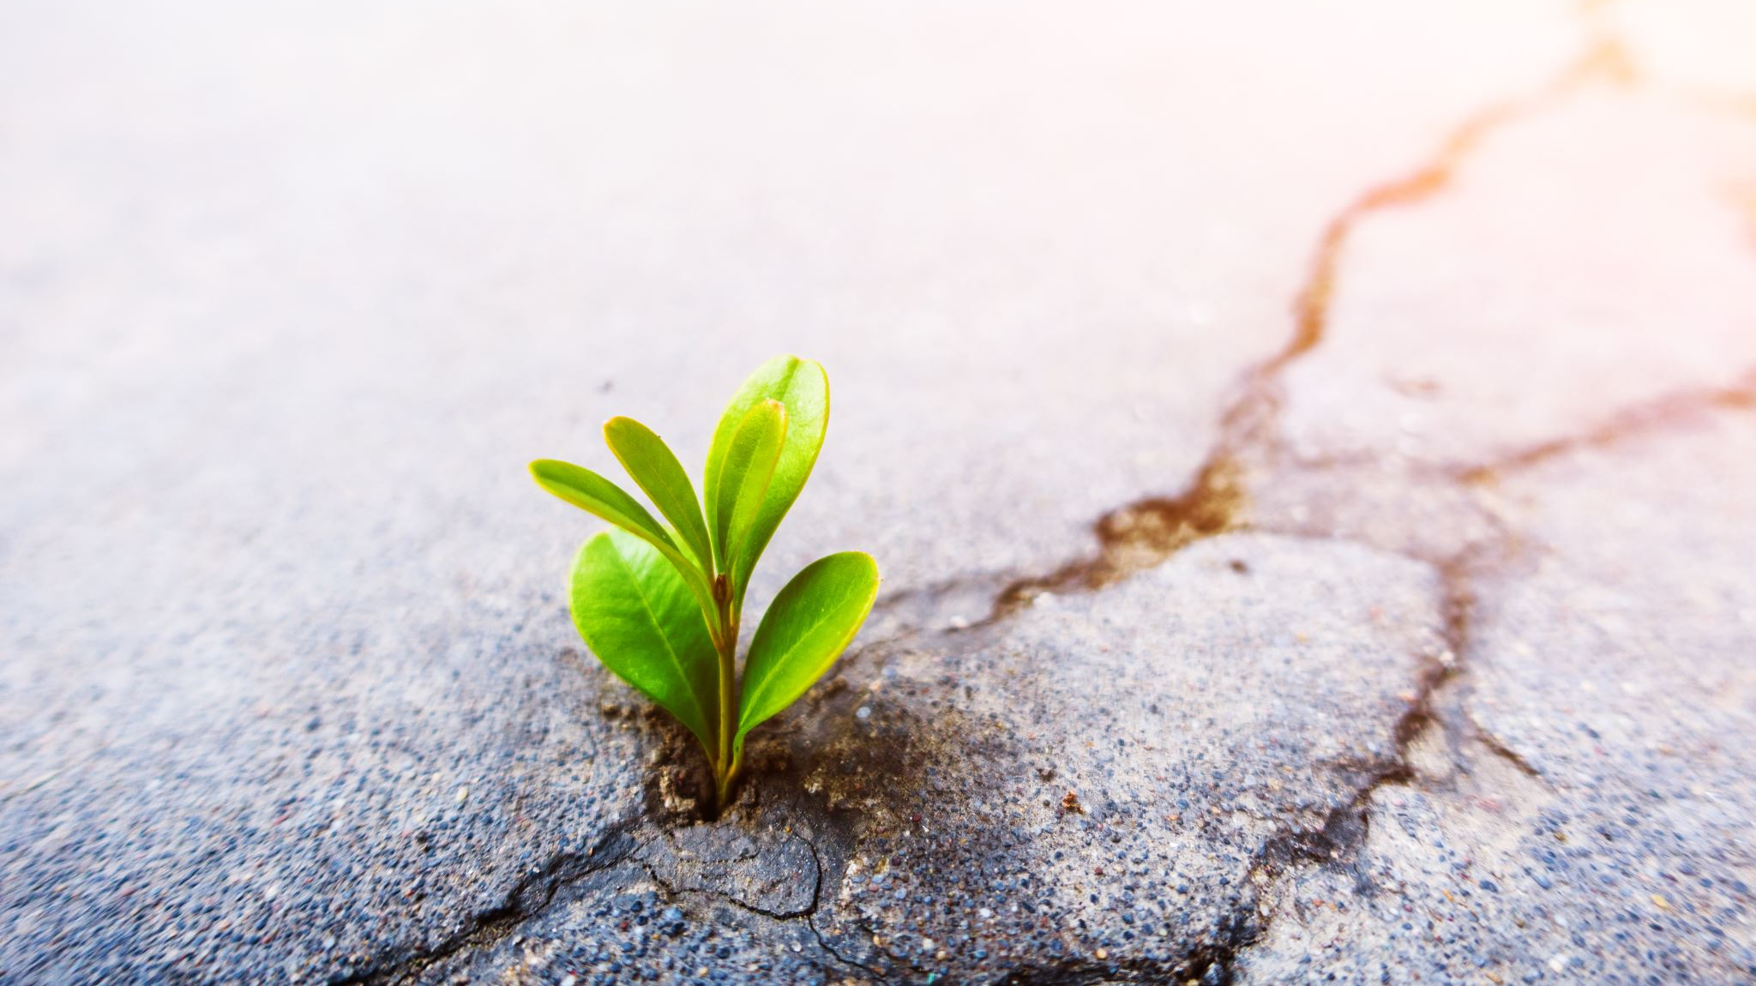
Environmental Storytelling: Learning to Write from Video Games
Meg Eden

Slide 2
“The natural object is always the adequate symbol”

Slide 3
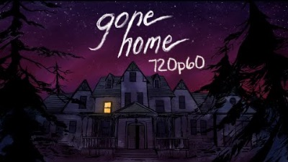

Slide 4

Why does environmental storytelling work?
It’s efficient. Doesn’t need explanations. Keeps it simple and focused.
We often feel like we need lots of backstory and exposition, but often this makes things more complicated and less focused. Keep it simple!
3:19-3.43

Slide 5
It requires us to “fill in the gaps” and contribute to the story, making us more invested, and the result all the more powerful. This makes them feel the same “aha!” as the characters, putting the pieces together.
Readers are smart; they can make conclusions on their own

Slide 6
It makes us participants who are invested. We ask questions. We put in our experiences and knowledge to figure out what’s going on. We feel tension. There’s a level of uncertainty, that lingering in the gaps, that make us think about a story long after we’ve finished reading/watching/playing.
We connect with the characters and situation more—we’re right there with them!
It’s also more memorable: visual, physical, tangible than an abstraction. We remember objects because they activate multiple parts of our brain. Sensory details draw us in!

Slide 7
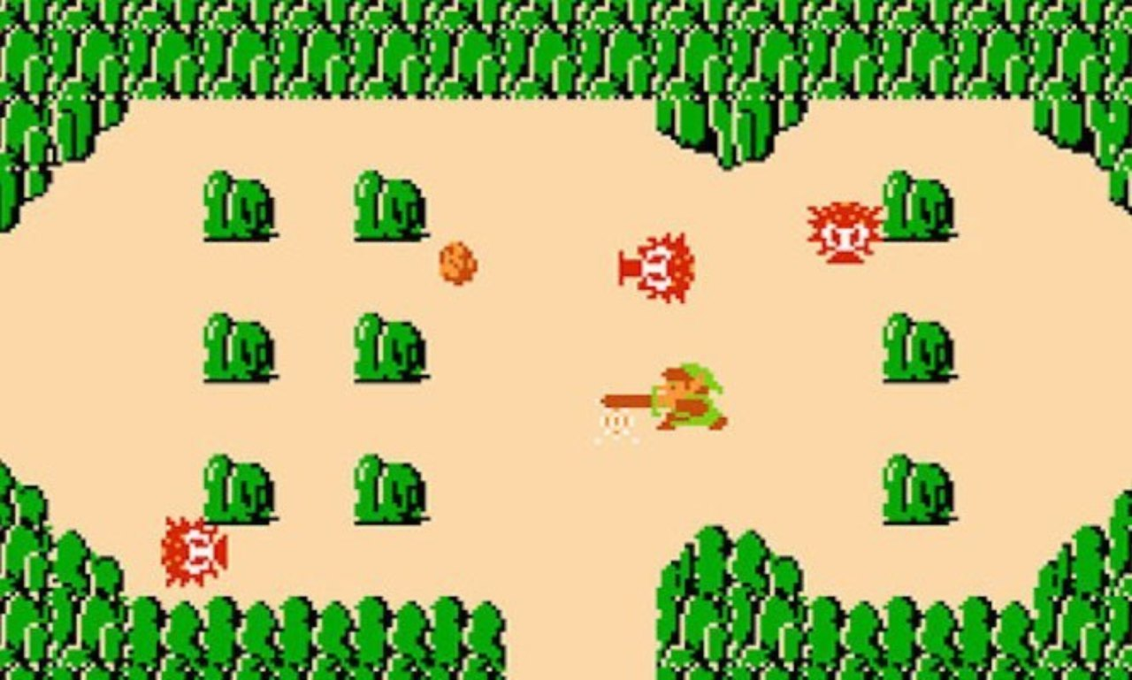
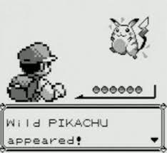
It’s personal, and connect to the human experience. We build a personal relationship with that space through our associations with those items
Writing and games are acts of exploration, fueled by memory and experience. Write what you know!

Slide 8
How can we use environmental storytelling in our own work?

Slide 9
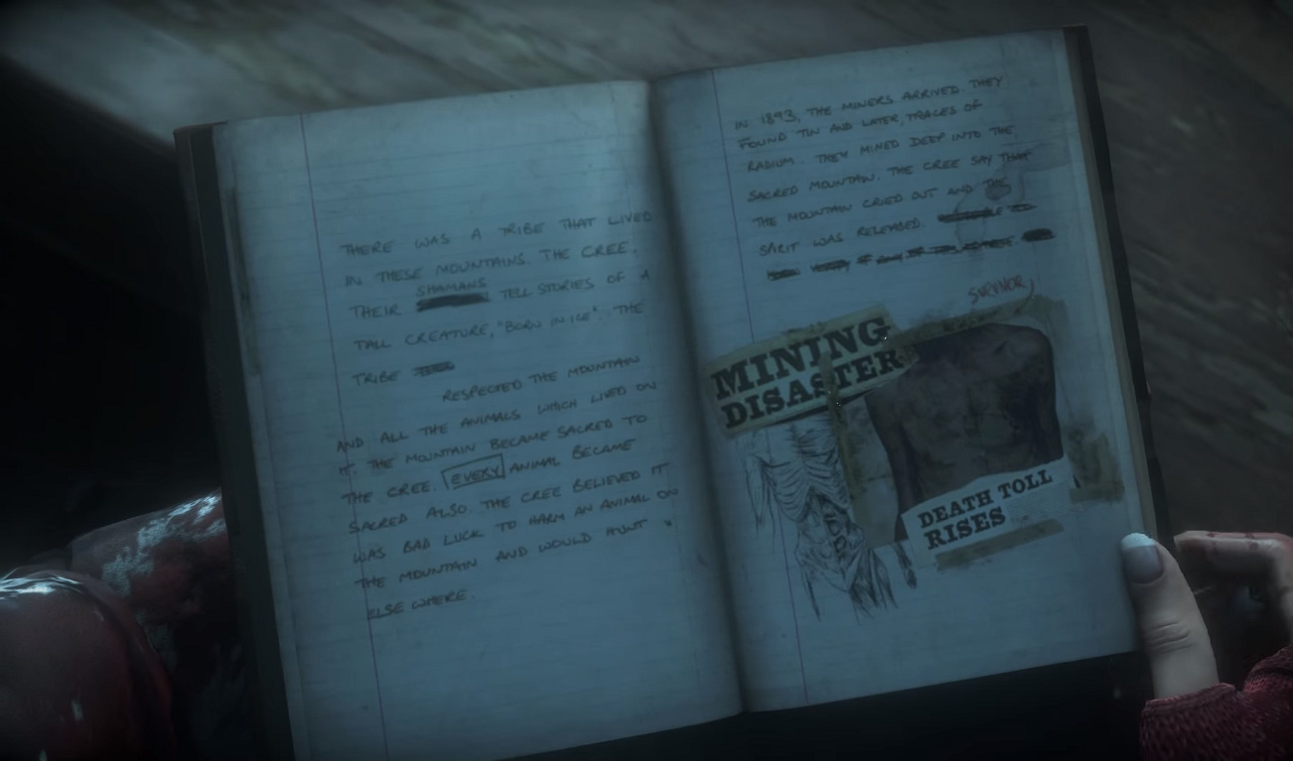
Context & Backstory

Slide 10
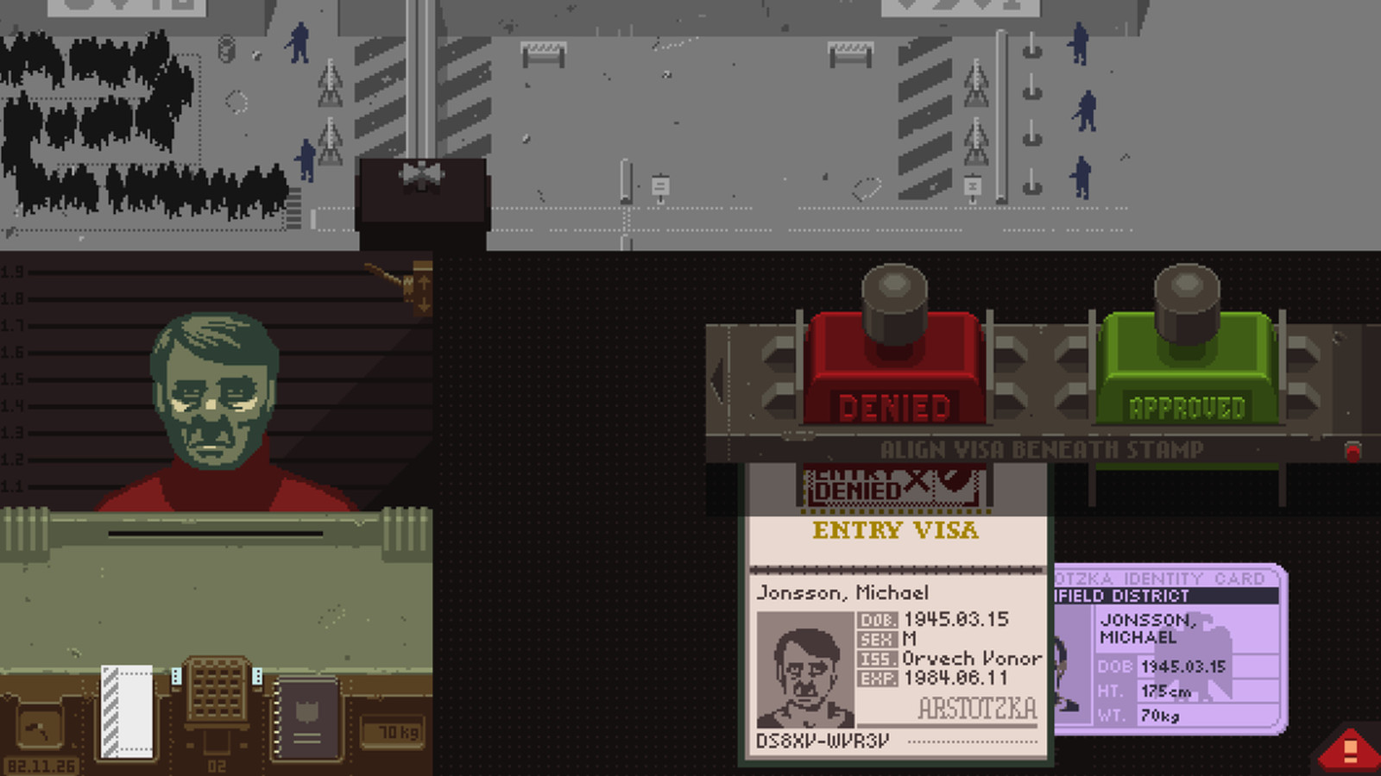
Raising the Stakes
Raising the Stakes

Slide 11
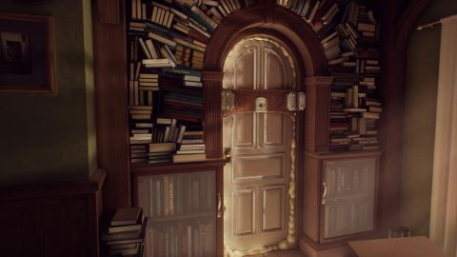
Where you can & can’t go

Slide 12
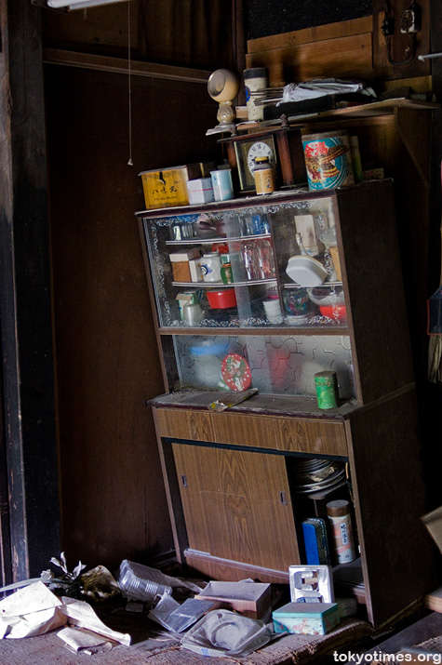
Past & Present

Slide 13
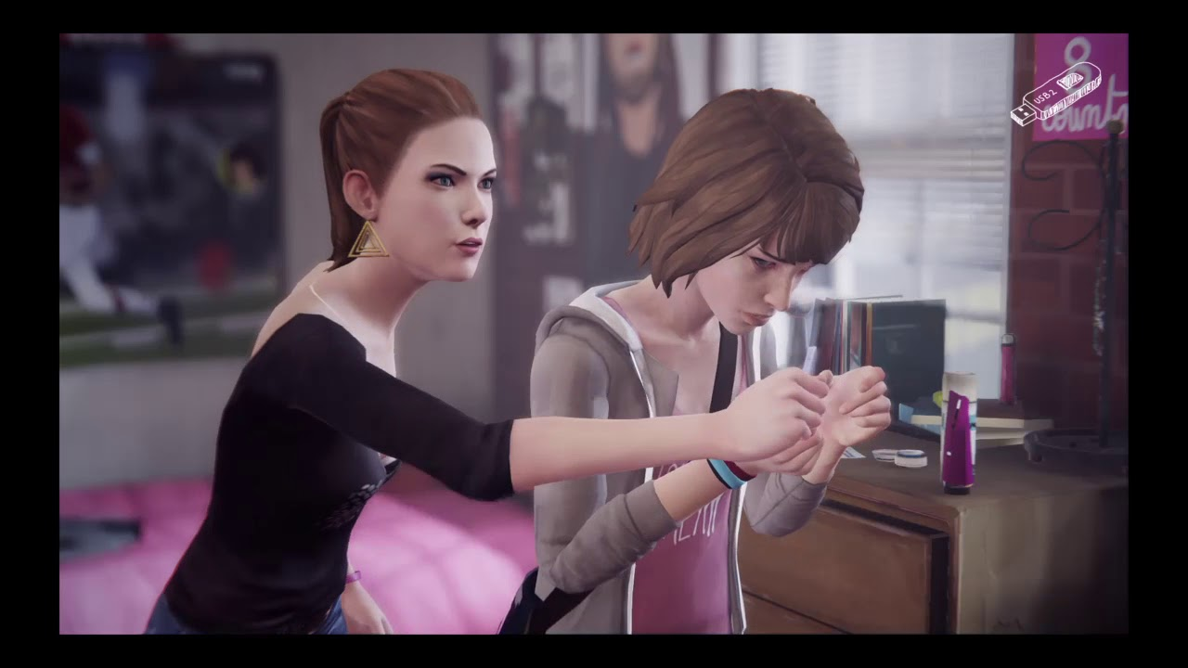
Conflict & Things Characters Wouldn’t Say

Slide 14
Ted Kooser: Abandoned Farmhouse
He was a big man, says the size of his shoes
on a pile of broken dishes by the house;
a tall man too, says the length of the bed
in an upstairs room; and a good, God-fearing man,
says the Bible with a broken back
on the floor below the window, dusty with sun;
but not a man for farming, say the fields
cluttered with boulders and the leaky barn.
A woman lived with him, says the bedroom wall
papered with lilacs and the kitchen shelves
covered with oilcloth, and they had a child,
says the sandbox made from a tractor tire.
Money was scarce, say the jars of plum preserves
and canned tomatoes sealed in the cellar hole.
And the winters cold, say the rags in the window frames.
It was lonely here, says the narrow country road.
Something went wrong, says the empty house
in the weed-choked yard. Stones in the fields
say he was not a farmer; the still-sealed jars
in the cellar say she left in a nervous haste.
And the child? Its toys are strewn in the yard
like branches after a storm—a rubber cow,
a rusty tractor with a broken plow,
a doll in overalls. Something went wrong, they say.

Slide 15
Prompt
Use the Ted Kooser “the ___ says ___” form, but explore a different space. You can do this with the literal form, or by writing with the object at the lead. What information do we learn about the place based on objects?
You can pick any place you’d like: a landscape from your memory, for your story, or if you don’t know where to start, consider choosing a picture from one of these haikyo sites.
Remember: Let the objects lead you!

