Slide 1


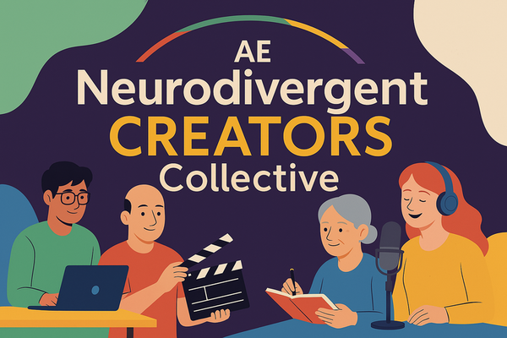
Autism Empowerment:
Neurodivergent Creators Collective
Welcome! We will be starting shortly!
Please feel free to introduce yourself in chat

Slide 2
Autism Empowerment:
Neurodivergent Creators Collective
Introduction to Independent Writing & Publishing

Slide 3

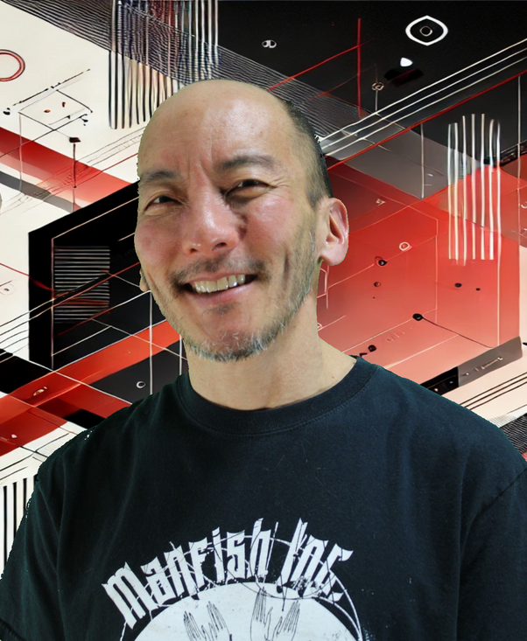
Autism Empowerment:
Neurodivergent Creators Collective
Welcome!!
Accept
Enrich
Inspire
Empower
Brian Tashima
Notes:
Brief Introduction and Welcome
Brain introduces himself and Autism Empowerment
Gwyn introduces herself and the Neurodivergent Creators Collective

Slide 4

Autism Empowerment:
Neurodivergent Creators Collective
So, You Want to Write a Book!
What we’re going to talk about today
Why do you want to write a book?
Notes:
Go around the room and let people introduce themselves. Gwyn will write answers on the easel.

Slide 5
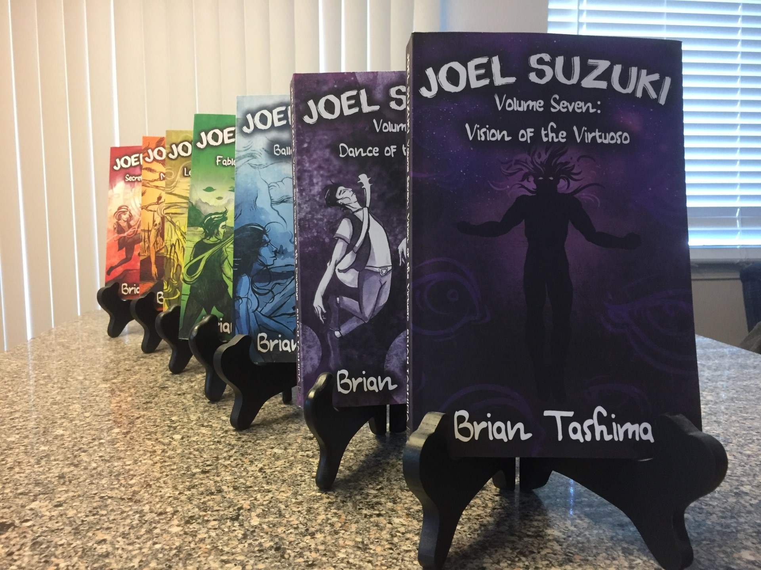
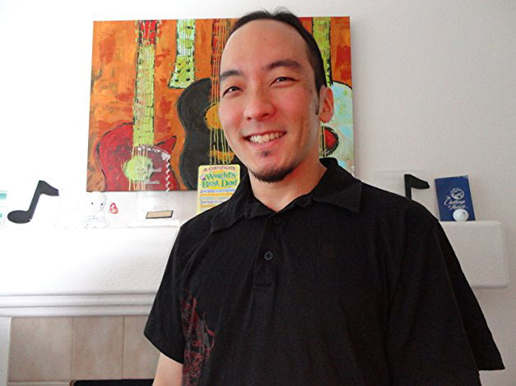
Autism Empowerment:
Neurodivergent Creators Collective
My Story
(the Joel Suzuki series)
Do you need previous writing experience or credentials?
How I learned to write
What could work for you
Notes:
Gwyn introduces “Above the Line”
Which of the things we’ve listed would you think are “Above the Line” Departments?

Slide 6
Autism Empowerment:
Neurodivergent Creators Collective
Resources
(books about how to write books)
Plot & Structure, James Scott Bell
Save the Cat! Writes a Novel, Jessica Brody
On Writing: A Memoir of the Craft, Stephen King
Writing Fiction or Memoir Writing for Dummies, various
Book in a Month, Victoria Lynn Schmidt
Notes:
Gwyn introduces “Above the Line”
Which of the things we’ve listed would you think are “Above the Line” Departments?

Slide 7


Autism Empowerment:
Neurodivergent Creators Collective
Now the real work starts!
Plotter or Pantser?
Setting goals
Overcoming writer’s block
How to stay on track
A few words about NaNoWriMo
Notes:
Gwyn introduces “Below the Line”

Slide 8


Autism Empowerment:
Neurodivergent Creators Collective
Your manuscript is done! Or is it?
Beta readers
Professional editors
Sensitivity readers
Revise, rewrite, revise, rewrite
Notes:
Gwyn introduces “Below the Line”

Slide 9
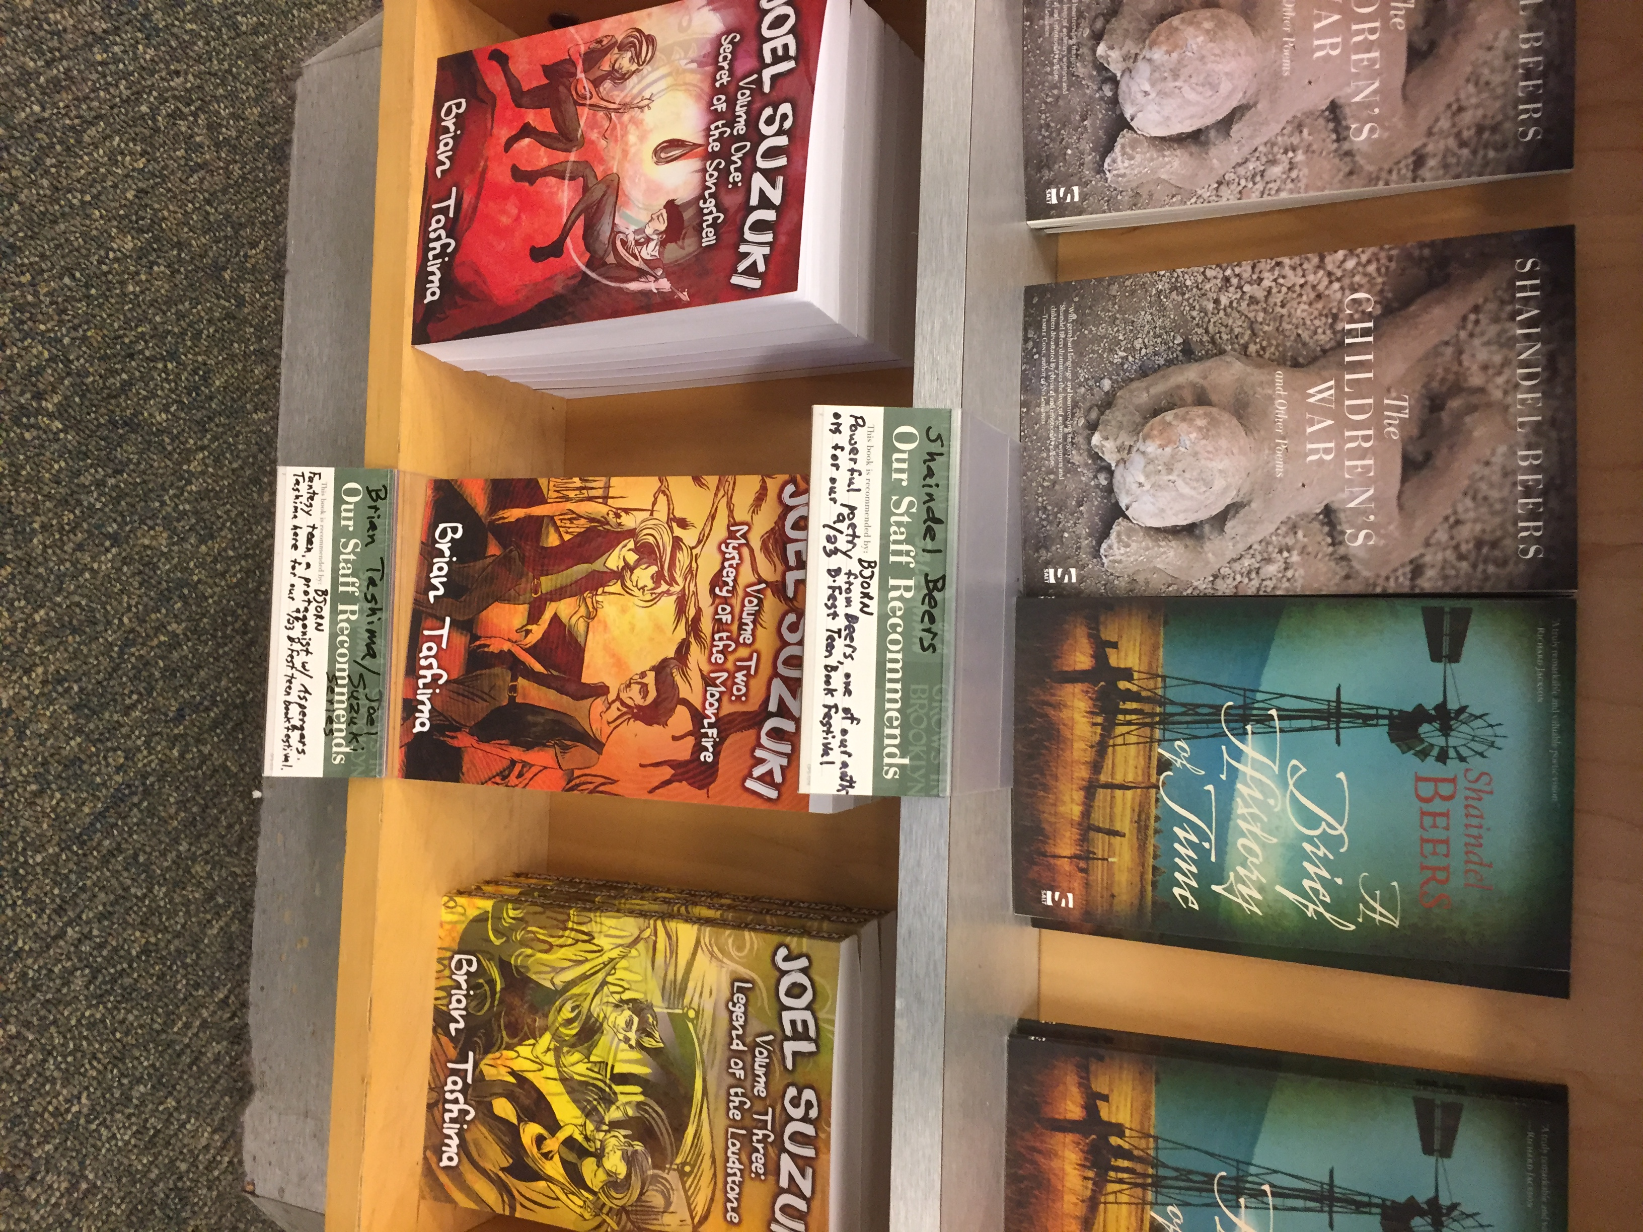

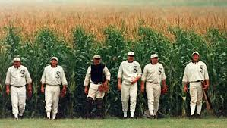
Autism Empowerment:
Neurodivergent Creators Collective
Publishing time!
Independent vs. traditional
Business considerations
Production
Distribution
Promotion (this is not “Field of Dreams”)
Notes:
Gwyn introduces “Below the Line”

Slide 10

Autism Empowerment:
Neurodivergent Creators Collective
A few words about “BookTok”
www.tiktok.com/@brian.tashima.author
Notes:
Gwyn introduces “Below the Line”

Slide 11

Autism Empowerment:
Neurodivergent Creators Collective
What’s next?
Keep writing!
And check out more resources at
www.autismempowerment.org/programs/aencc/ae-ncc-resource-library/
Notes:
Gwyn introduces “Below the Line”

Slide 12

Autism Empowerment:
Neurodivergent Creators Collective
What do YOU think?
Notes:
Participant’s questions and any further discussion needed.

Slide 13

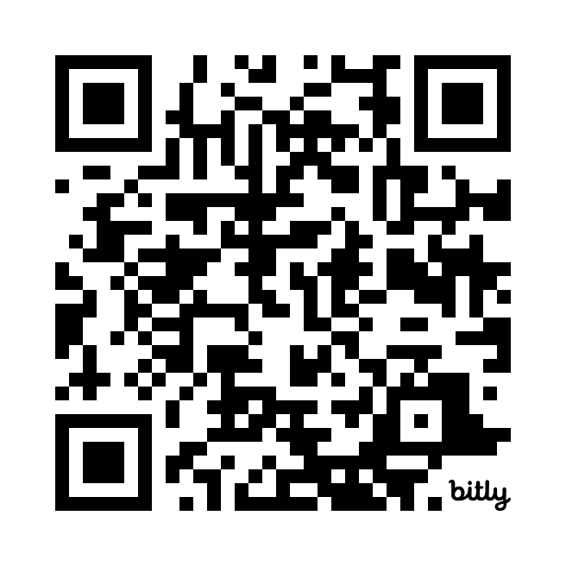
Autism Empowerment:
Neurodivergent Creators Collective
Upcoming Workshops:
Pre-Production Planning for Filmmaking
Saturday, July 25, 2026 @ 2:00pm Pacific
With Edward Martin III of Hellbender Media
Documentary Filmmaking
Saturday, August 22, 2026 @ 2:00pm Pacific
With Emmy-winning filmmaker Beth Harrington
Take our interest survey to let us know what you are most interested in!
Notes:
Gwyn talks briefly about Voice Over and Podcasting and Brian talks about his writing.

Slide 14



Autism Empowerment:
Neurodivergent Creators Collective
How to Connect with Us!
Brian Tashima - brian@autismempowerment.org
www.AutismEmpowerment.org/aencc
www.facebook.com/groups/aencc
Notes:
Participant’s questions and any further discussion needed.

