Slide 1


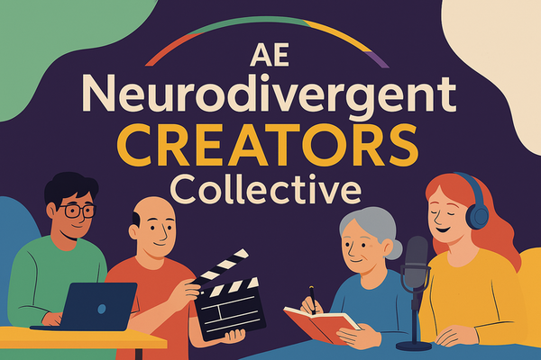
Autism Empowerment:
Neurodivergent Creators Collective
Welcome! We will be starting shortly!
Please feel free to introduce yourself in chat

Slide 2

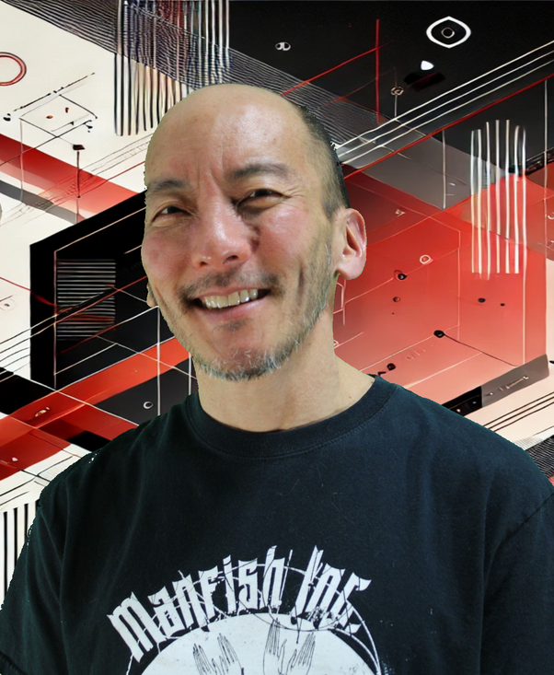
Autism Empowerment:
Neurodivergent Creators Collective
Welcome!!
Accept
Enrich
Inspire
Empower
Brian Tashima

Slide 3
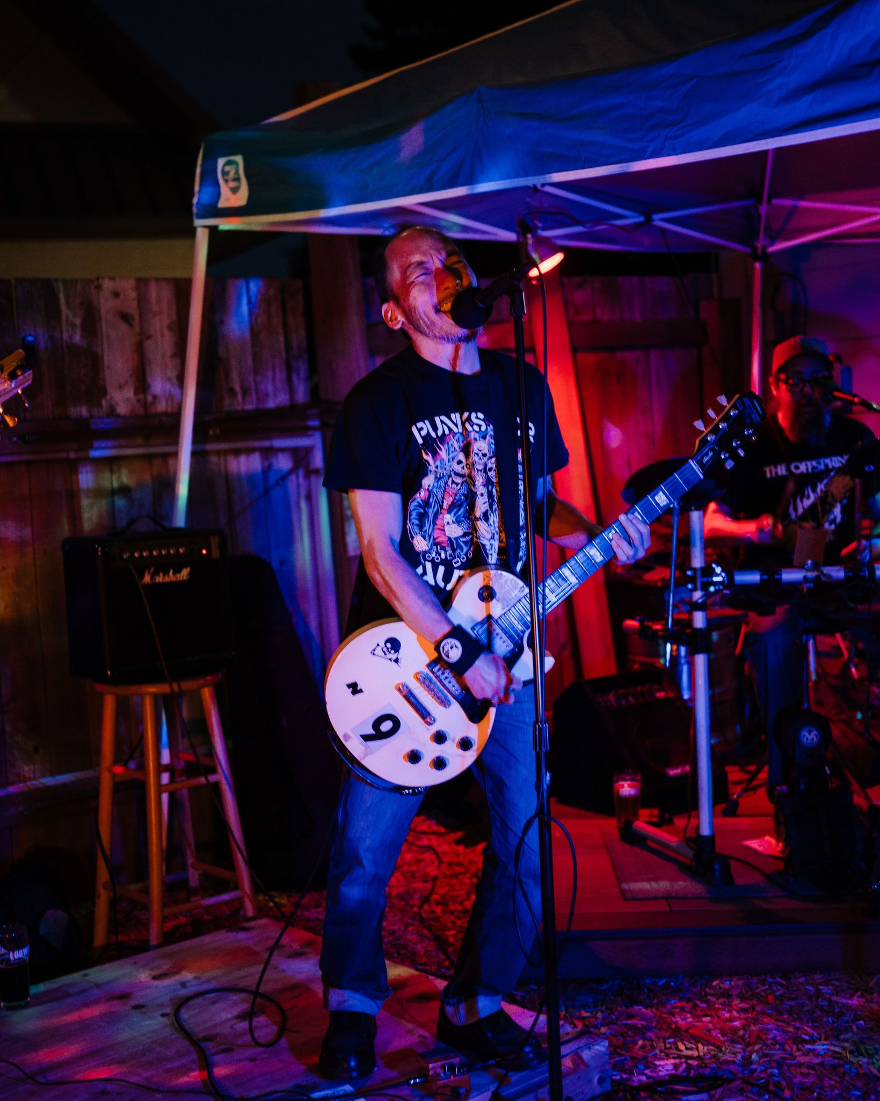


Autism Empowerment:
Neurodivergent Creators Collective
Songwriting Boot Camp

Slide 4


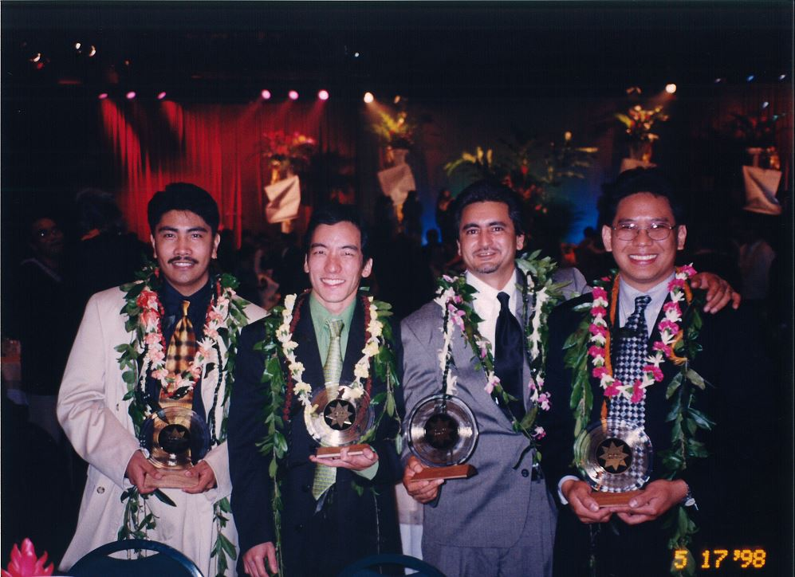

Autism Empowerment:
Neurodivergent Creators Collective
My Background

Slide 5

Autism Empowerment:
Neurodivergent Creators Collective
Why write songs?
(Note: we will cover mostly pop/rock. There are other styles and genres that have their own “rules” but it helps to know general conventions)

Slide 6
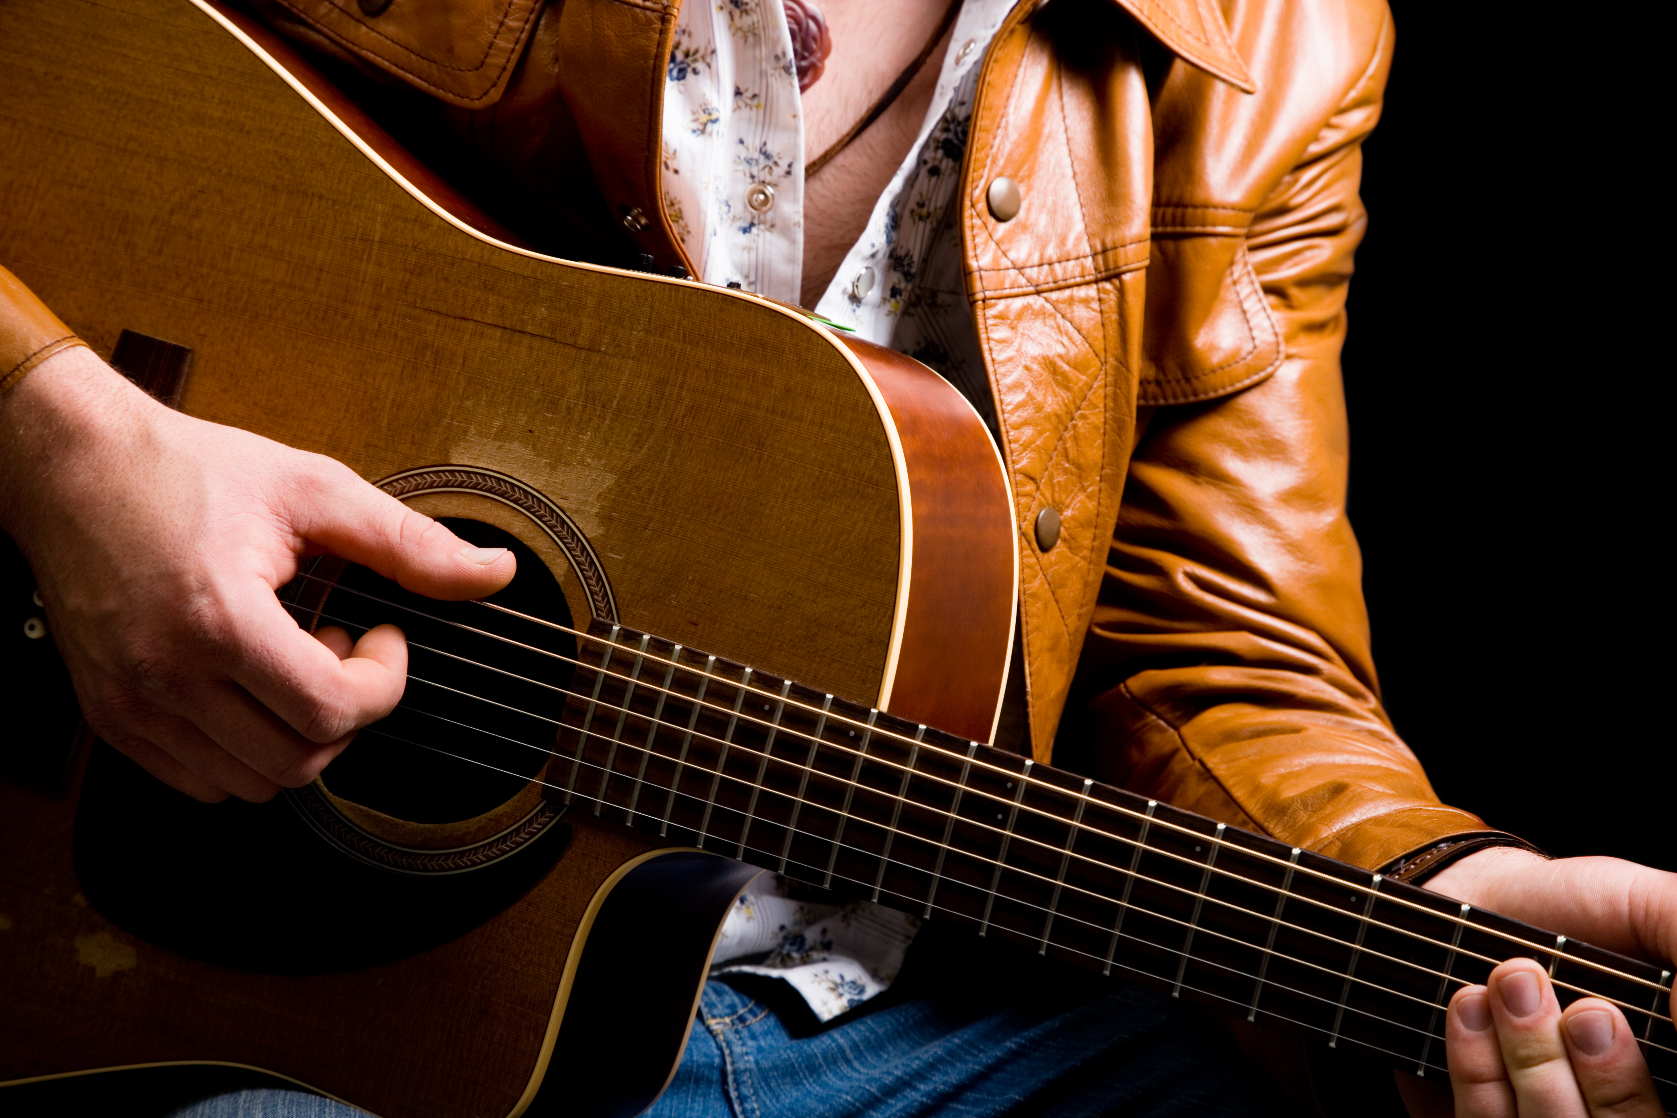

Autism Empowerment:
Neurodivergent Creators Collective
Where to start, music or lyrics?

Slide 7
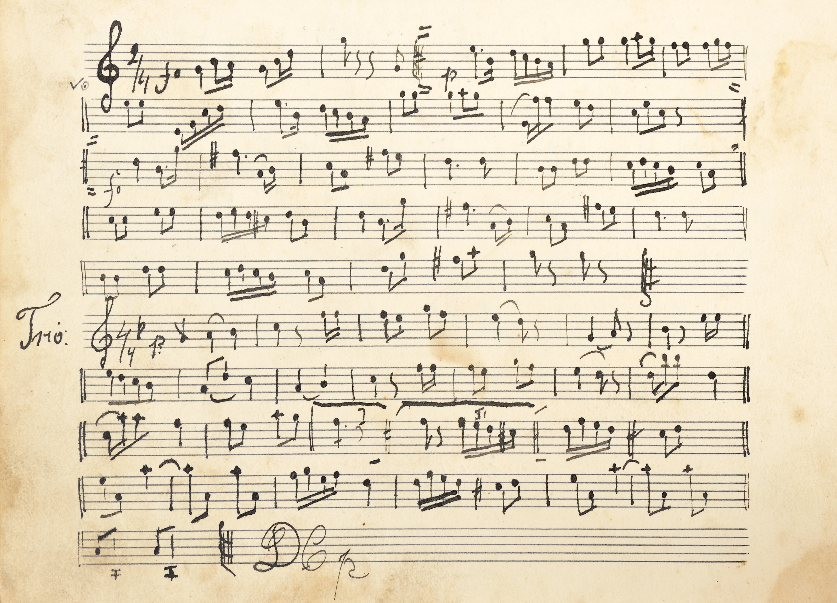
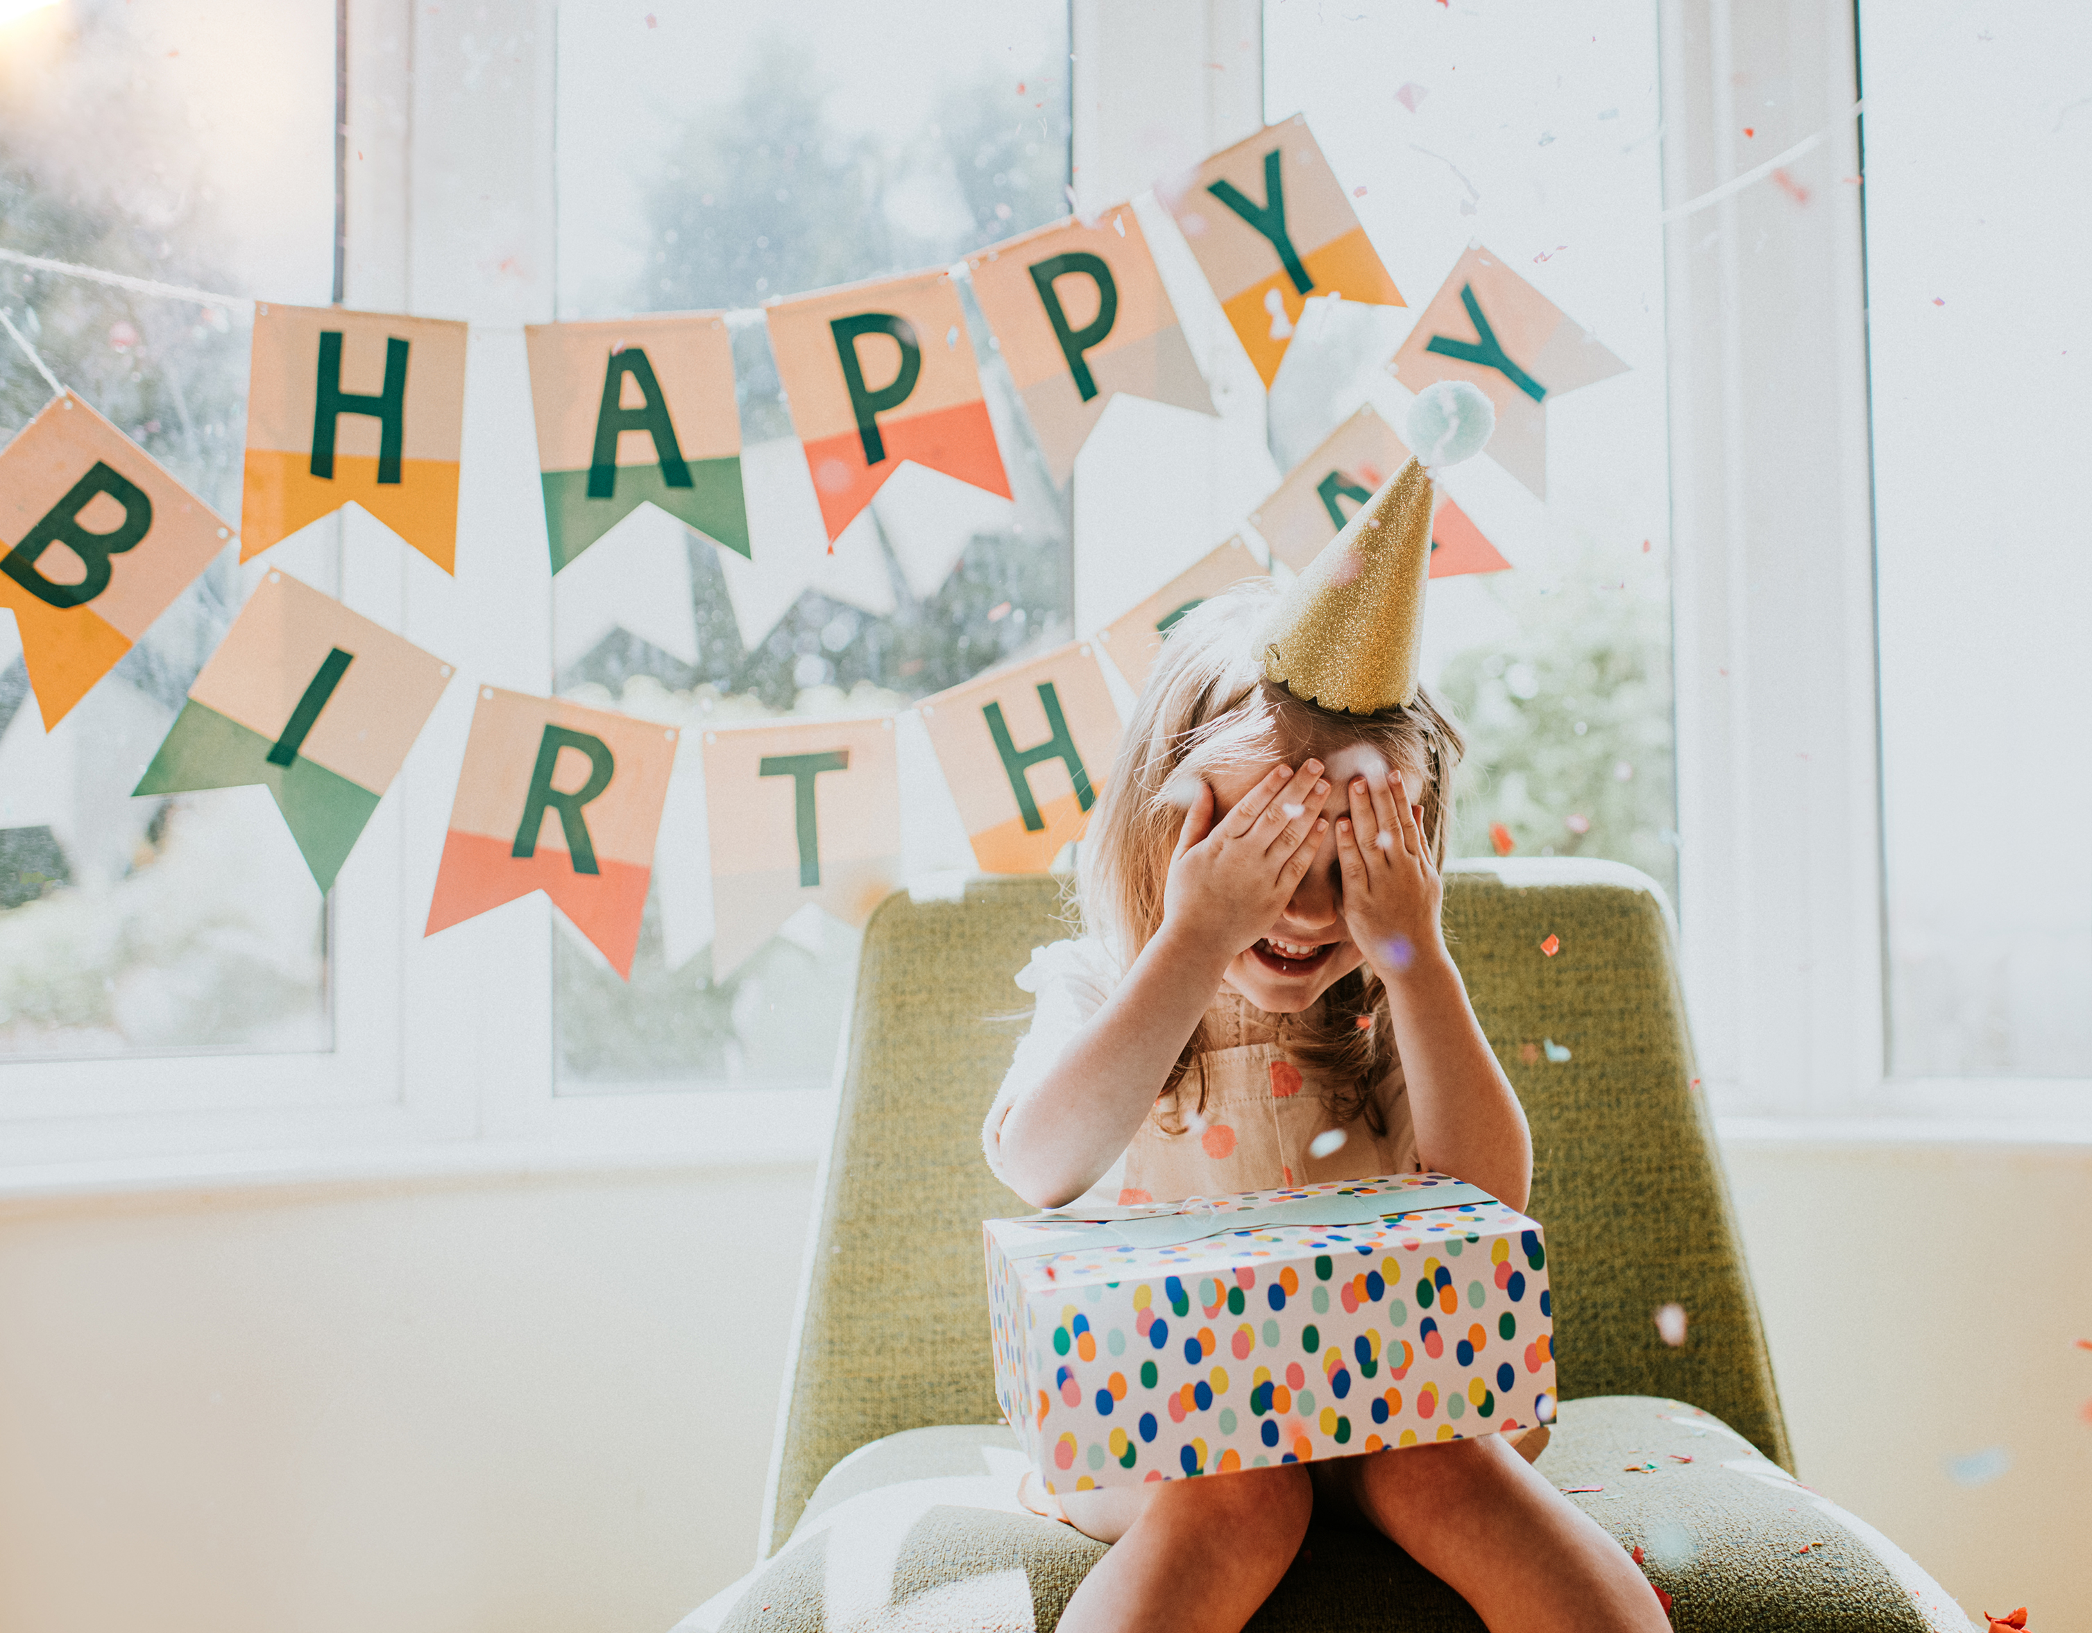
Autism Empowerment:
Neurodivergent Creators Collective
Song structure and
How to craft catchy melodies

Slide 8
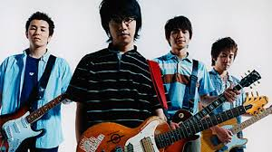
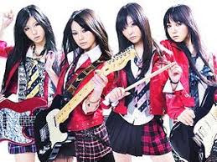
Autism Empowerment:
Neurodivergent Creators Collective
Western vs Eastern
(Or, “Why are Anime Theme Songs So Good?”)

Slide 9
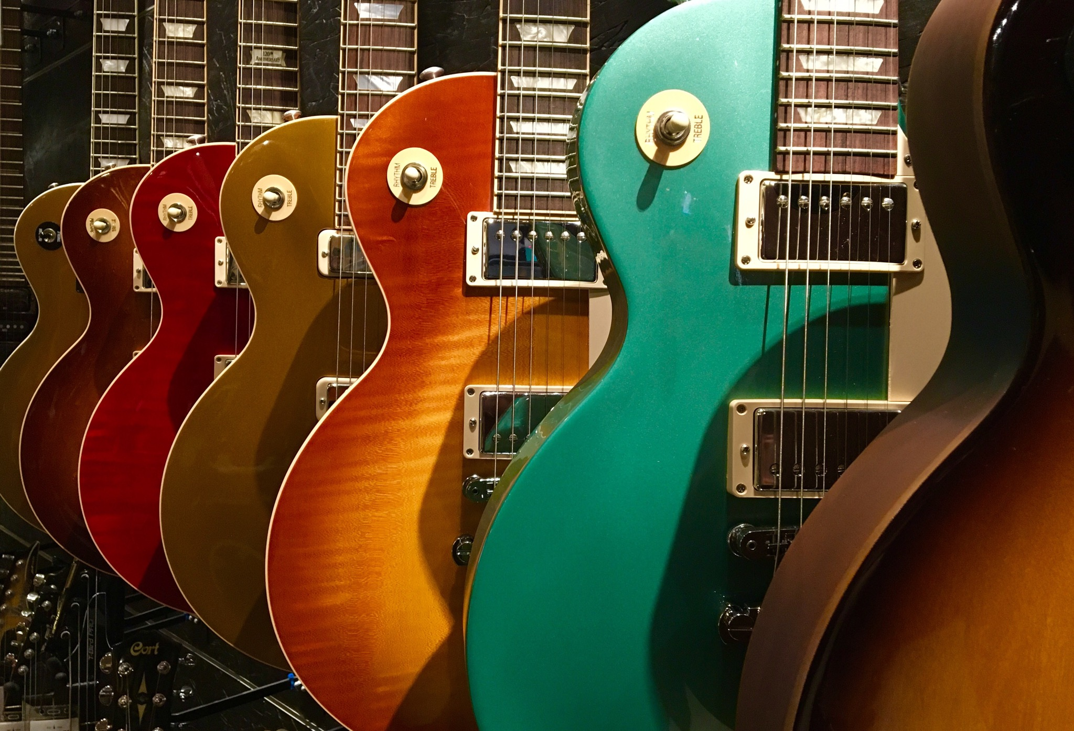
Autism Empowerment:
Neurodivergent Creators Collective
Other Tips
Reverse engineering
Finding your own voice
Tailoring songs to the performer
Four chords of awesome
Most songs are simple
Should sound good without fancy production
Write, write, write some more
There are no rules!

Slide 10

Autism Empowerment:
Neurodivergent Creators Collective
The Business of Songwriting
Performance Royalties
Mechanical Royalties
Sync Licensing Fees
Print Royalties
Sync Libraries

Slide 11
Autism Empowerment:
Neurodivergent Creators Collective
Resources
Shortcuts to Hit Songwriting, Robin Frederick
Songwriting for Dummies, various
Rhyming dictionaries/online sites
And check out more resources at
www.autismempowerment.org/programs/aencc/ae-ncc-resource-library/

Slide 12

Autism Empowerment:
Neurodivergent Creators Collective
What do YOU think?

Slide 13
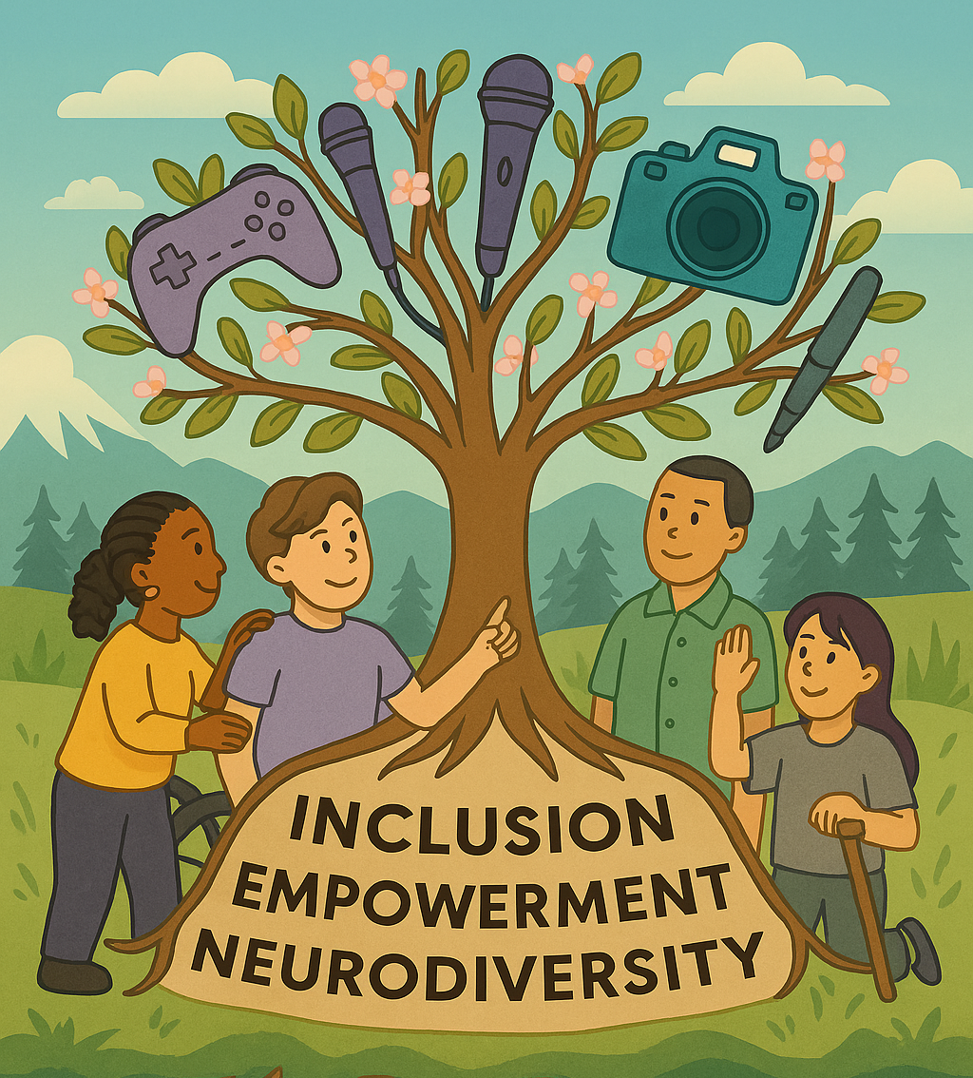
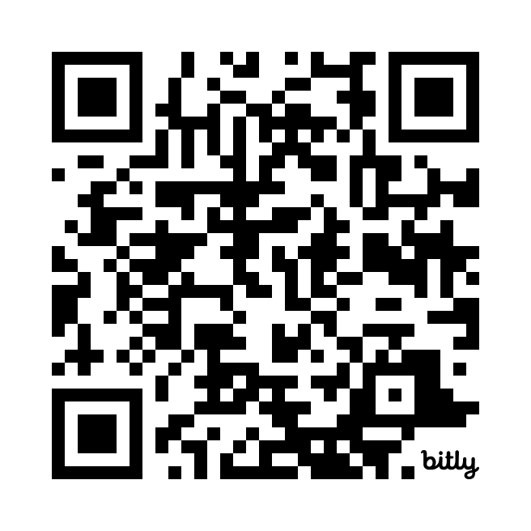
Autism Empowerment:
Neurodivergent Creators Collective
Upcoming Workshops:
Costume Design
Saturday, October 17, 2026 @ 2:00pm Pacific
With Tanya English
Documentary Film Screening: The Art of Belonging
Saturday, November 21, 2026 @ 2:00pm Pacific
With Annette King and Janet Miller
Take our interest survey to let us know what you are most interested in!

Slide 14



Autism Empowerment:
Neurodivergent Creators Collective
How to Connect with Us!
Brian Tashima - brian@autismempowerment.org
www.AutismEmpowerment.org/aencc
www.facebook.com/groups/aencc

